Slide 1
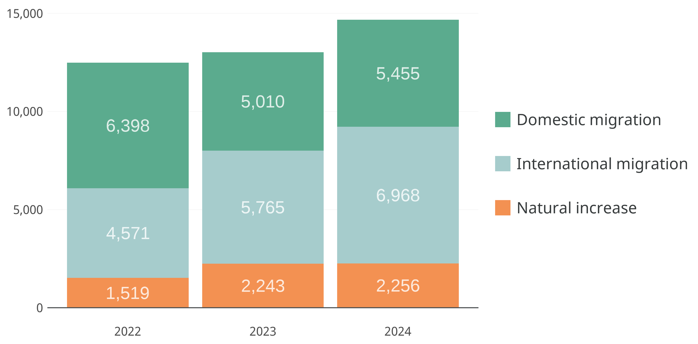

Most new residents arrive in moving vans, not baby strollers
Annual components of population change: 2022 to 2024
Source: U.S. Census Bureau, Population Estimates Program

Slide 2
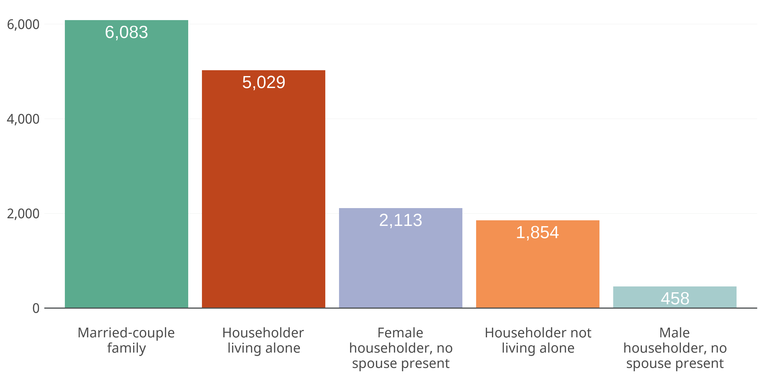
Single-person household growth nearly on pace with married families
Change in households by type: 2021 to 2023
Source: U.S. Census Bureau, American Community Survey, Table B11001

Slide 3
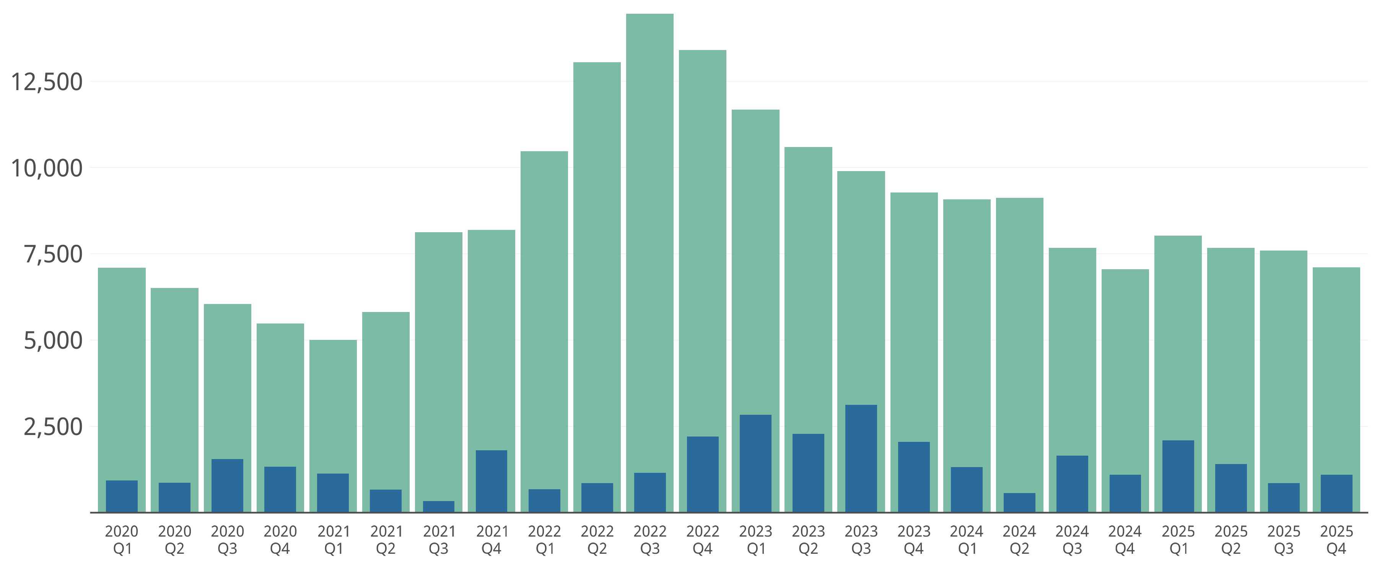
Apartment production slowing after post-pandemic “mini boom”
Multifamily units under construction and delivered: 2020 Q1 to 2025 Q4
Under Construction
Deliveries
Source: CoStar Group, Inc.

Slide 4
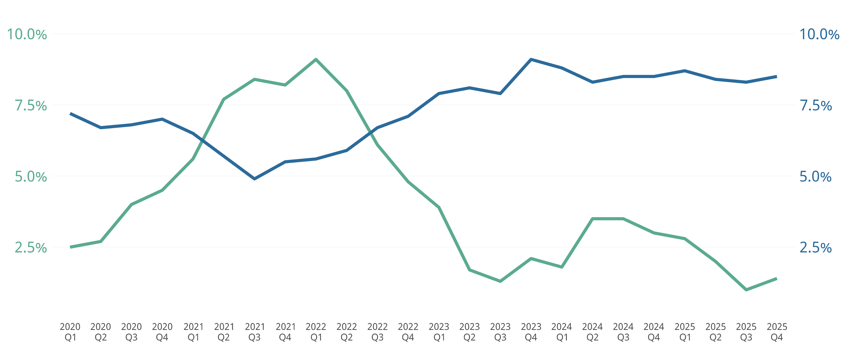
Rent growth cooling as new supply comes online
Average asking rent YOY growth and vacancy rate: 2020 Q1 to 2025 Q4
Vacancy Rate
Average Asking Rent
YOY Growth
Source: CoStar Group, Inc.

Slide 5
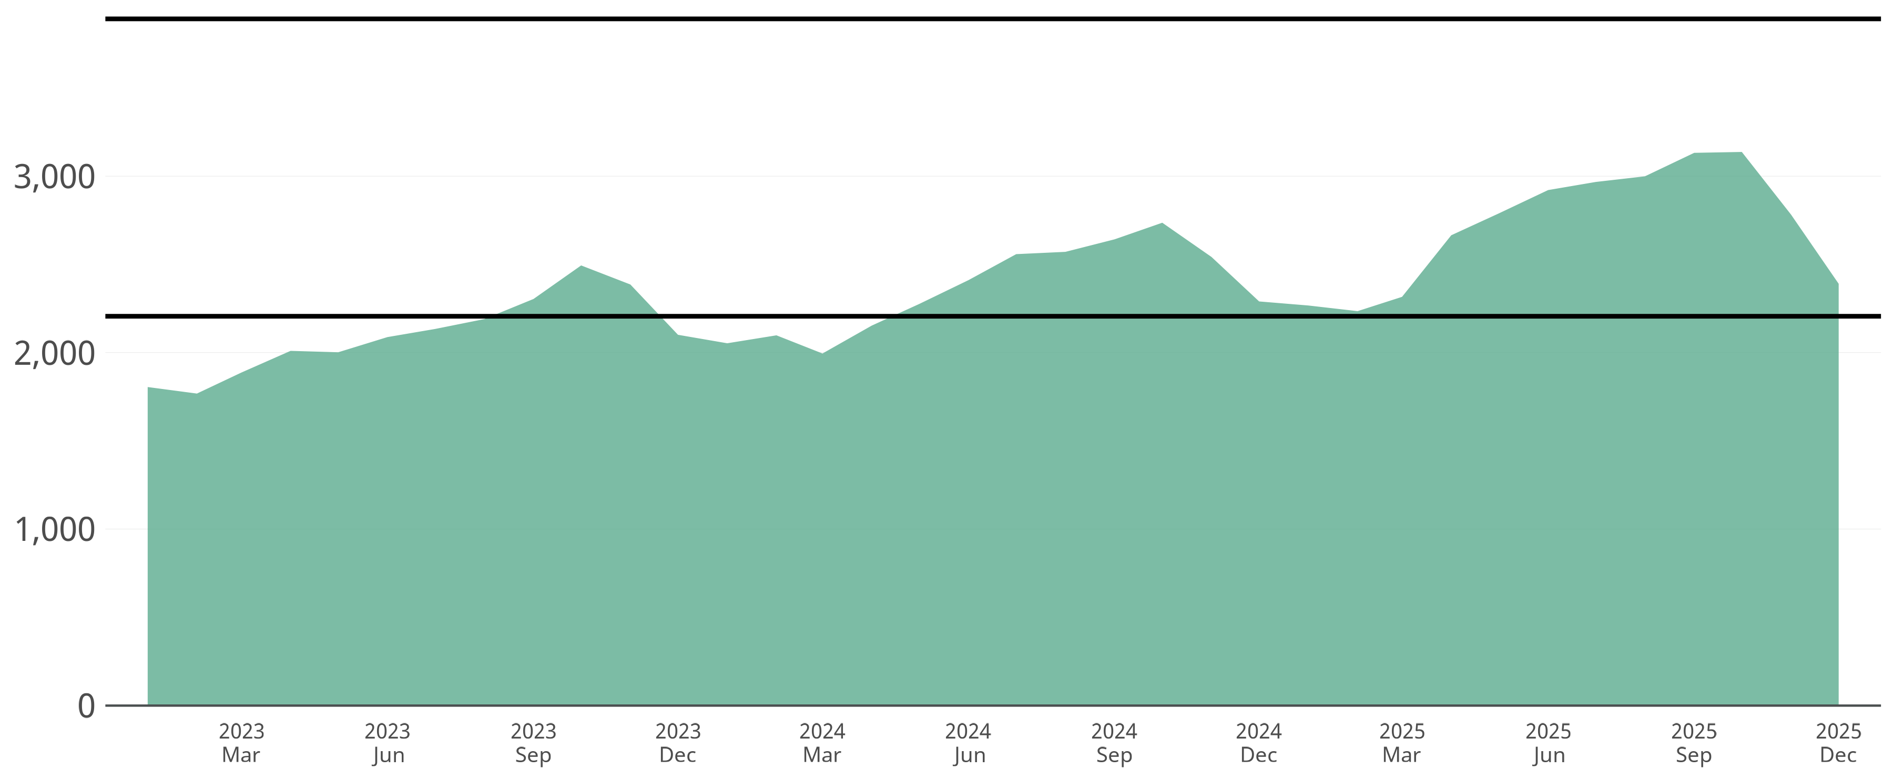
Monthly listings on the rise, but remain historically low
Number of active listings per month: Jan 2023 to Dec 2025
▲ 2016-2019 Average:
3,891
▼ 2020-2022 Average:
2,206
Source: CVR MLS

Slide 6
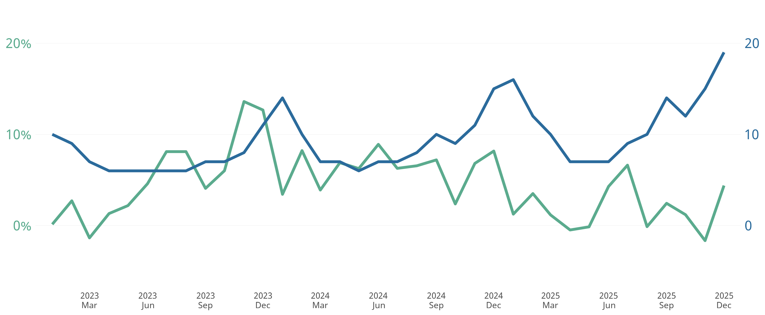
Buyers finally beginning to have more options
Average days to sell and YOY median sales price growth: Jan 2023 to Dec 2025
2025 Q4 Median Sales Price
$417,500
Average Days to Sell
Median Sales Price
YOY Growth
Source: CVR MLS

